Slide 1
Board Games Extravaganza
Kornel Krysiak & Michał Szałański

Slide 2
First, few words on the dataset
17 000 board games from Board Game Geek.
All have > 30 reviews.
Also: 13 000 000 reviews, each with a number and optionally a comment.
Source: https://www.kaggle.com/jvanelteren/boardgamegeek-reviews
Collected in 2019.

Slide 3
Let’s see the data.

Slide 4
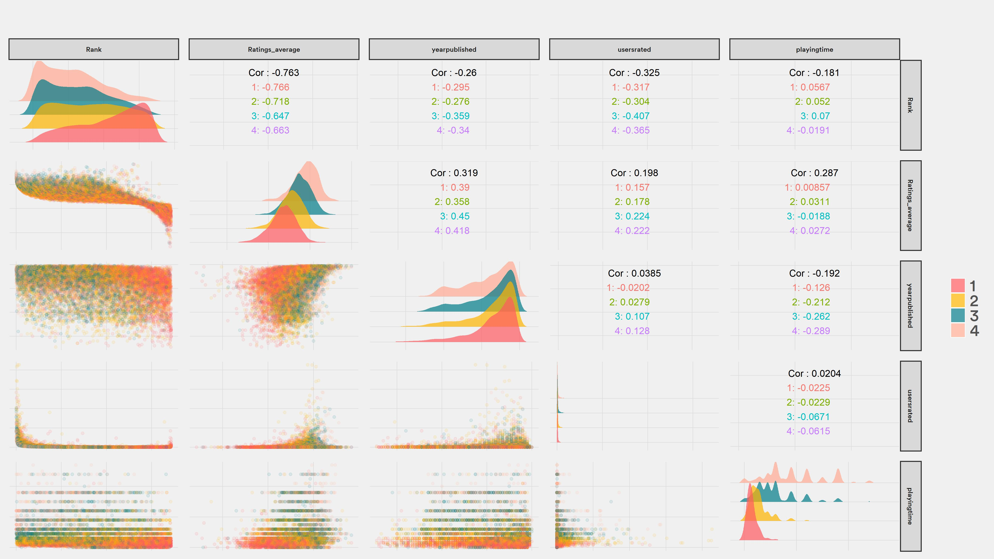

Slide 5
Are there more games each year?

Slide 6
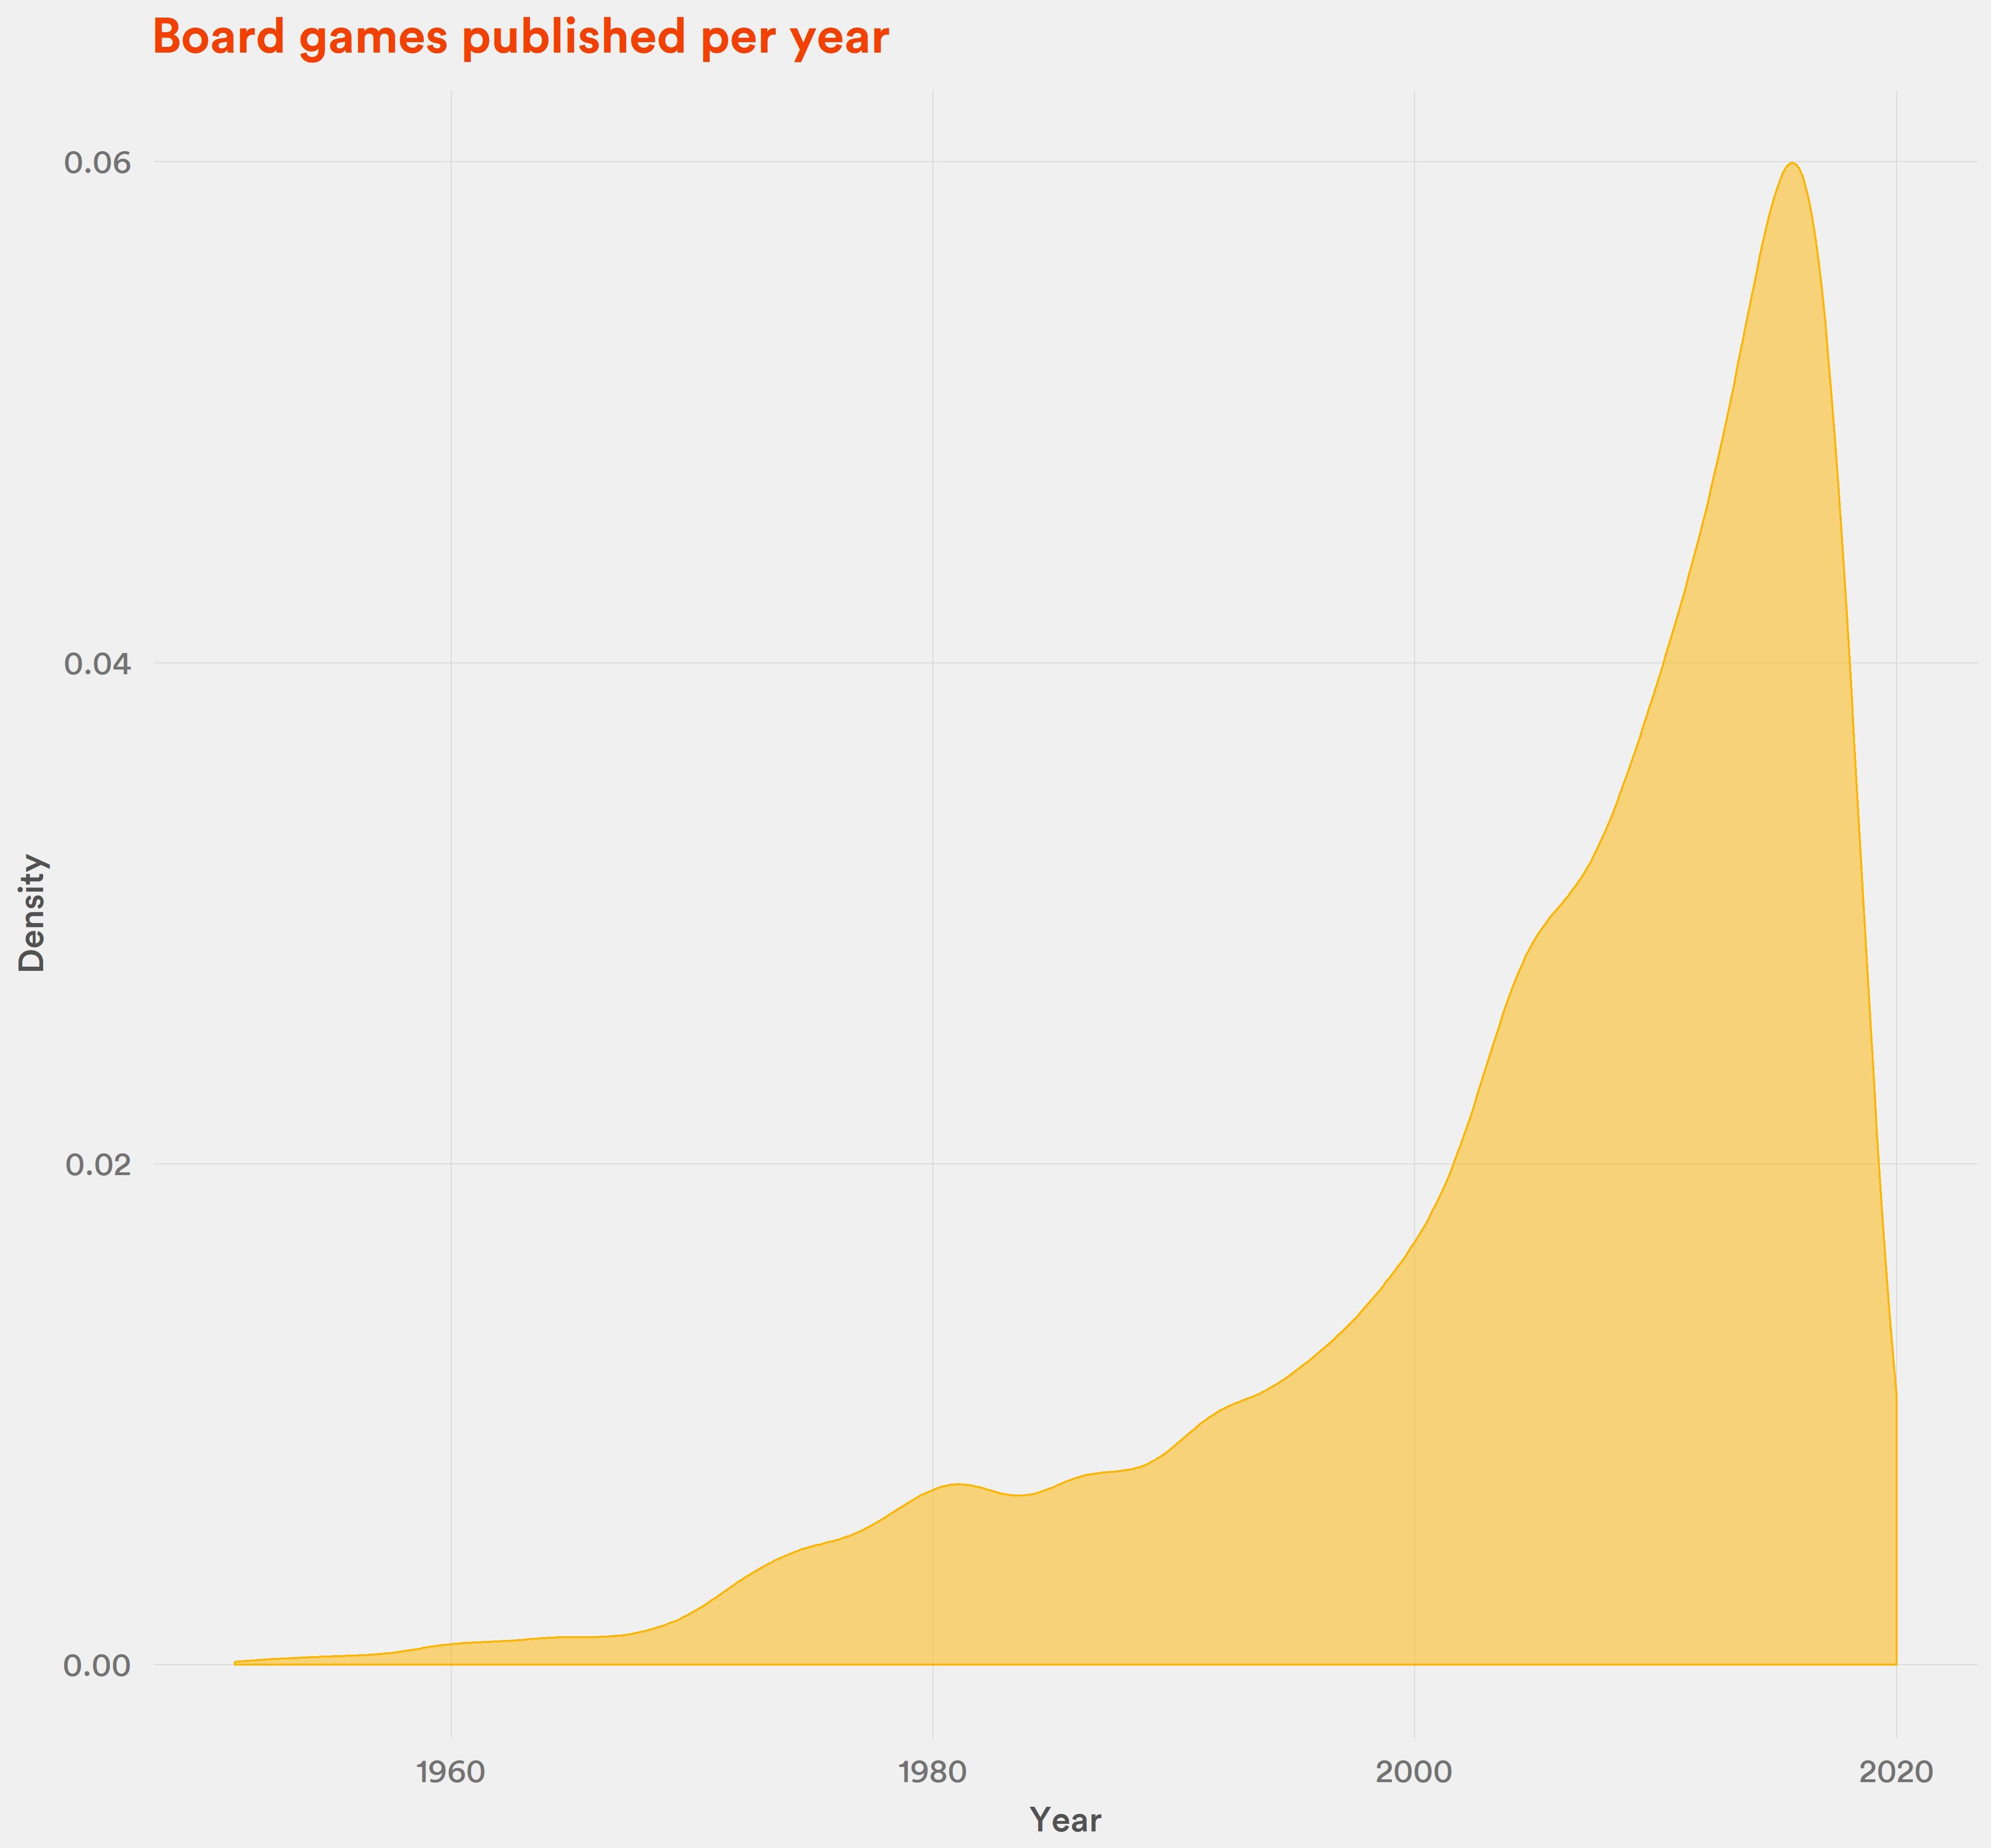
Definitely.
Compared to 2000, the number of games published in 2019 nearly tripled.

Slide 7
But, are they getting better?

Slide 9
It looks like there is some positive effect for games that came out max 3-4 years ago. Also, notice the preorder hype.

Slide 10
Board Game Geek is quite a „nerdy” place. Do less complex, „party” games get lower scores?

Slide 11
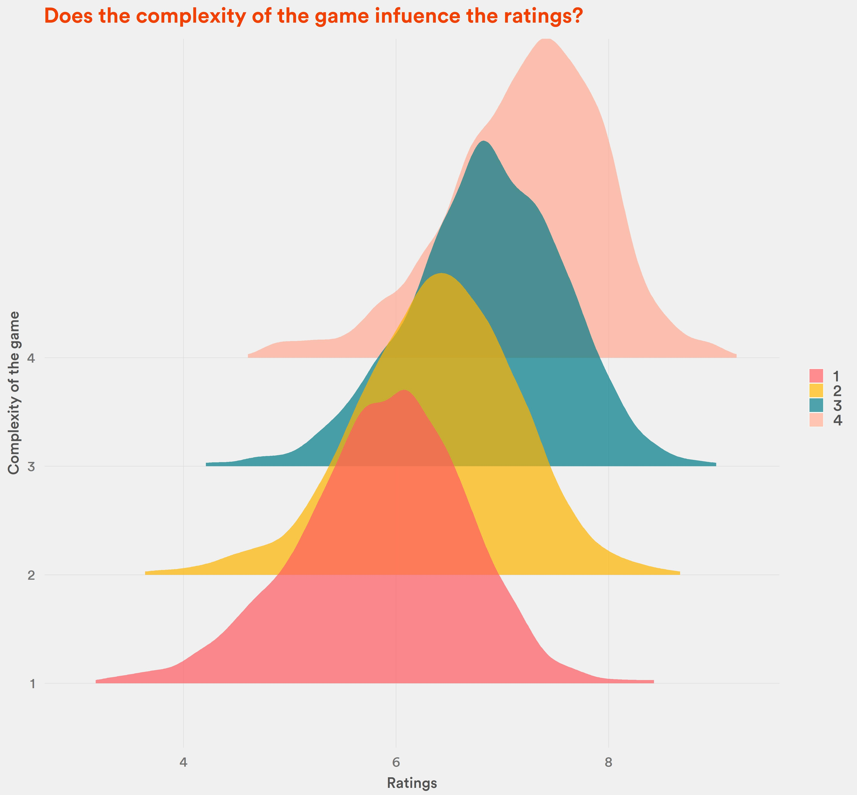
Yes.
Simple games are rated at around 6.
Very complex games: at 7.5

Slide 12
How exactly is the rank determined? Does average rating and number of reviews matter?

Slide 13
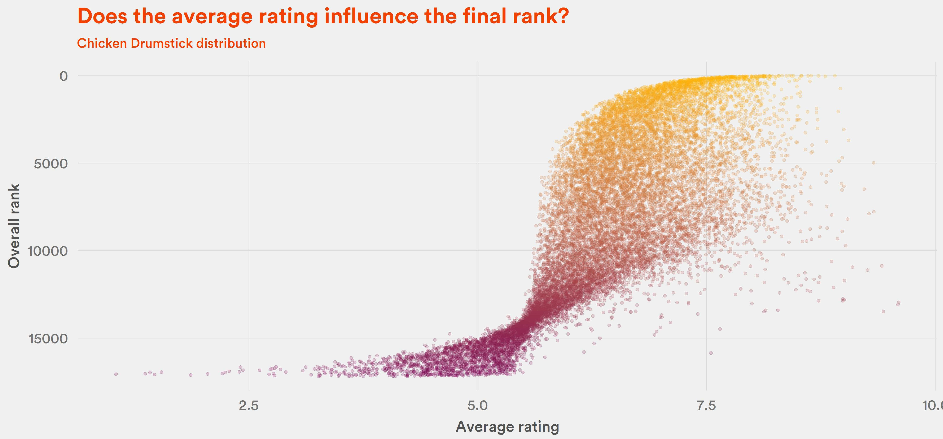
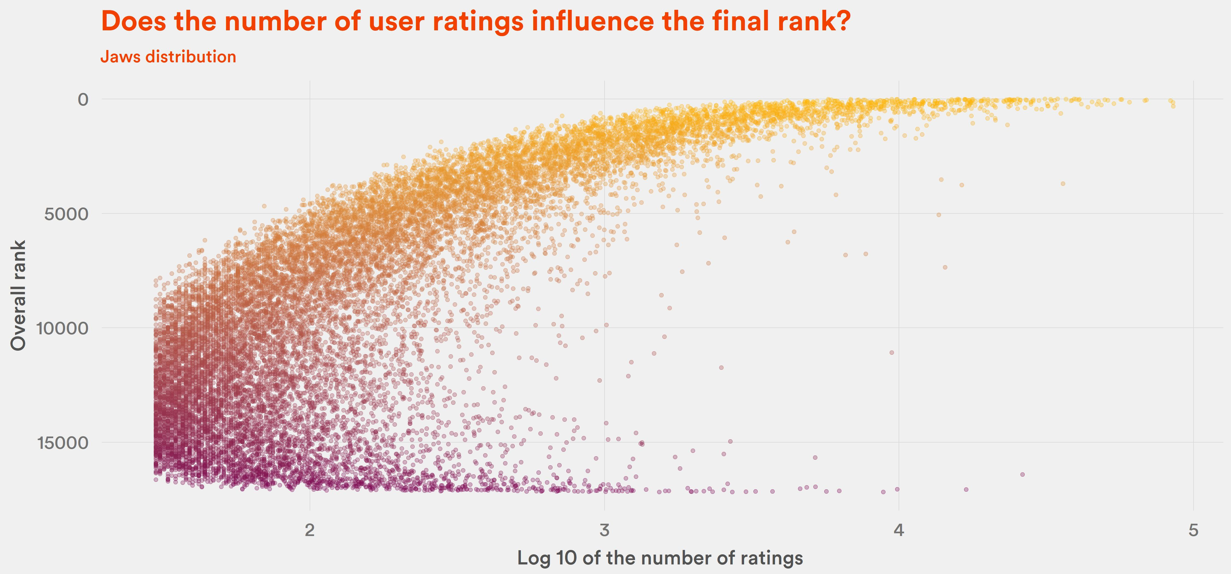
Yes, but not in a straightforward way.

Slide 14
Maybe the category influences the rank?

Slide 15
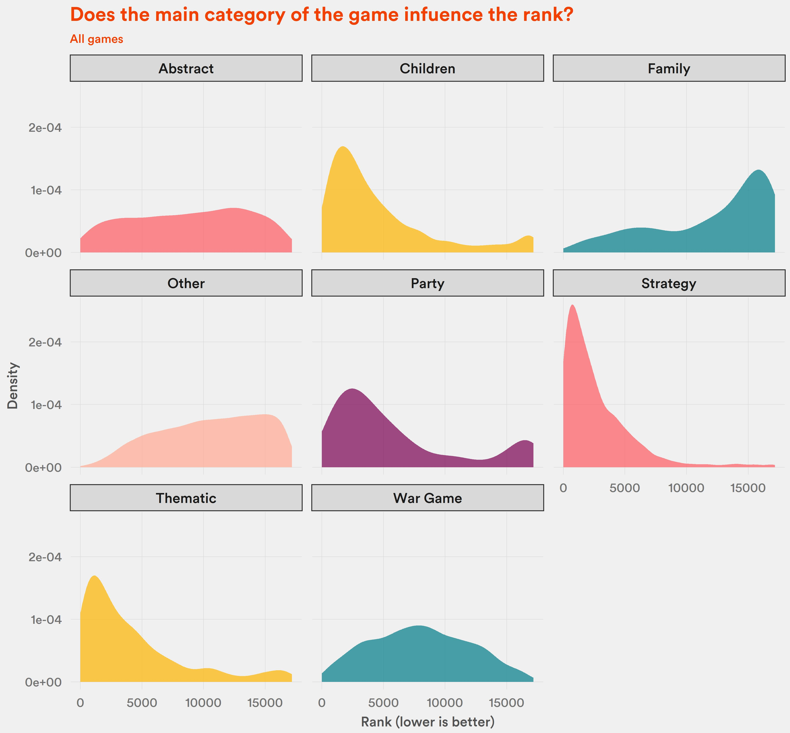
For all games – yes.
Strategy is highly favored, while family is disfavored.

Slide 16
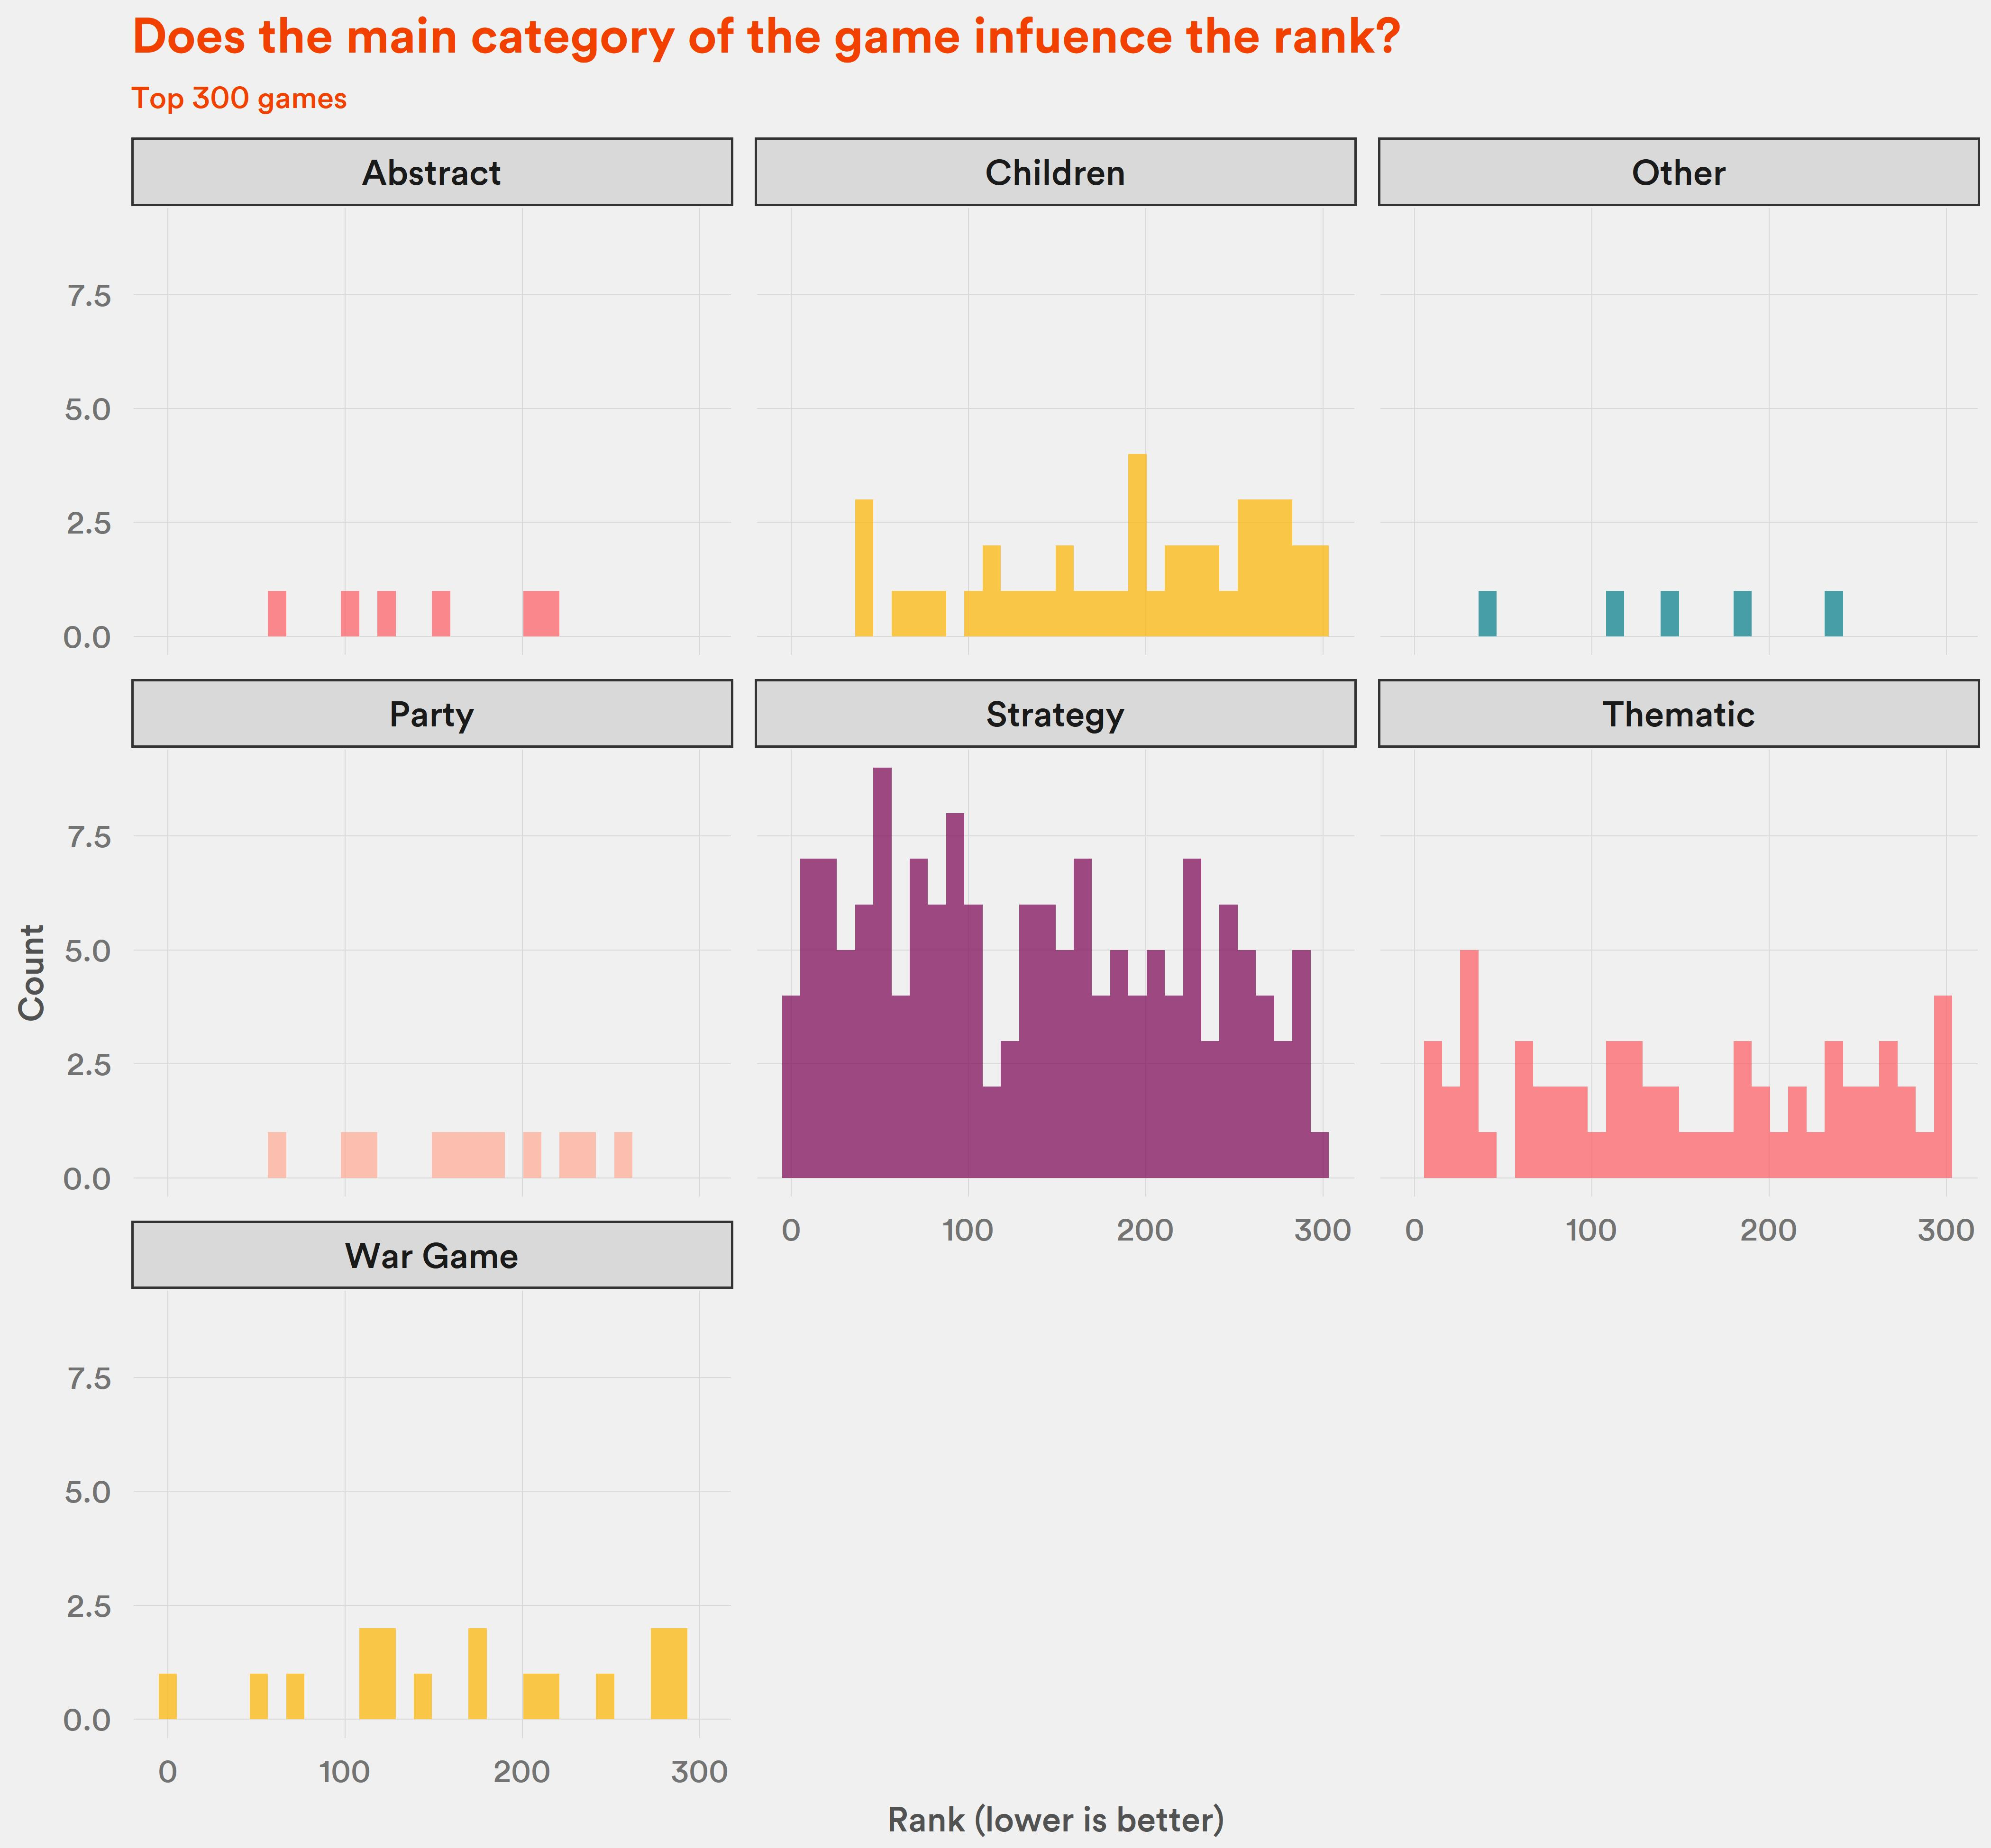
For top 1% - even more.
Strategy games dominate the 1%.

Slide 17
What about popularity?
People adding games to their wishlists.

Slide 18
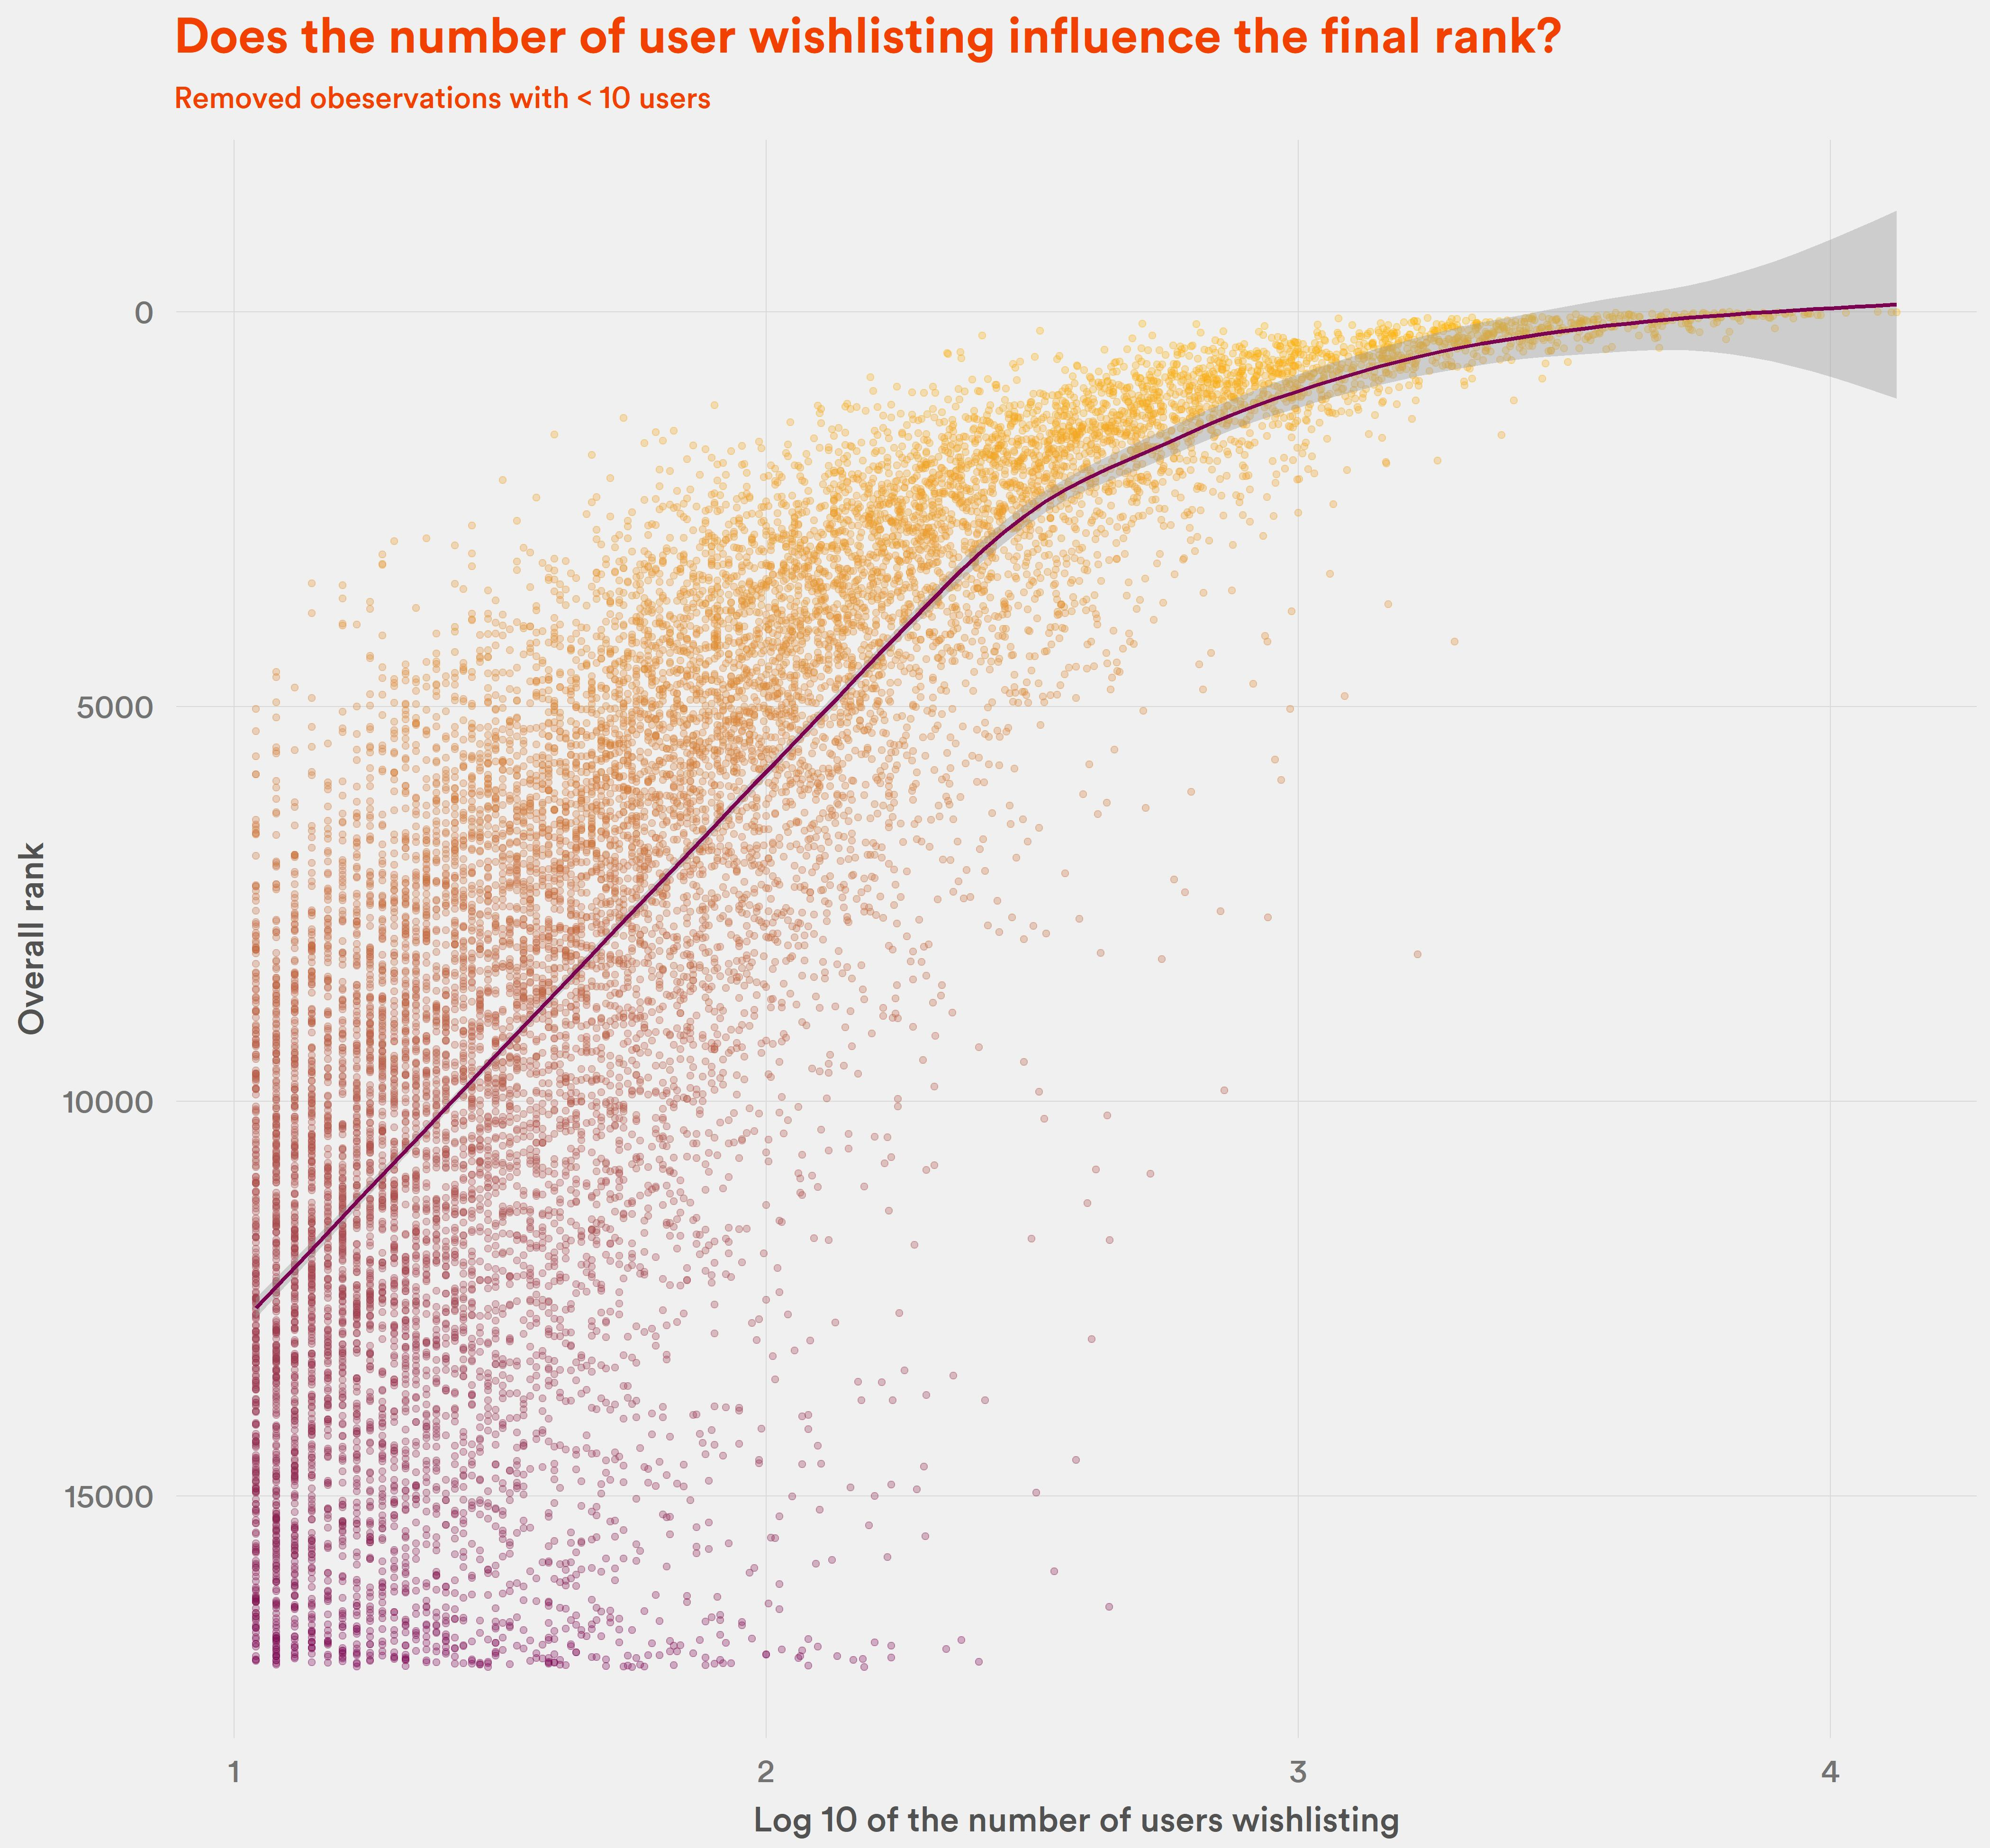
Yes.
Although this may be a reverse correlation:
Game is high in the ranking -> People want to buy it.

Slide 19
What does not influence the ranking?

Slide 20
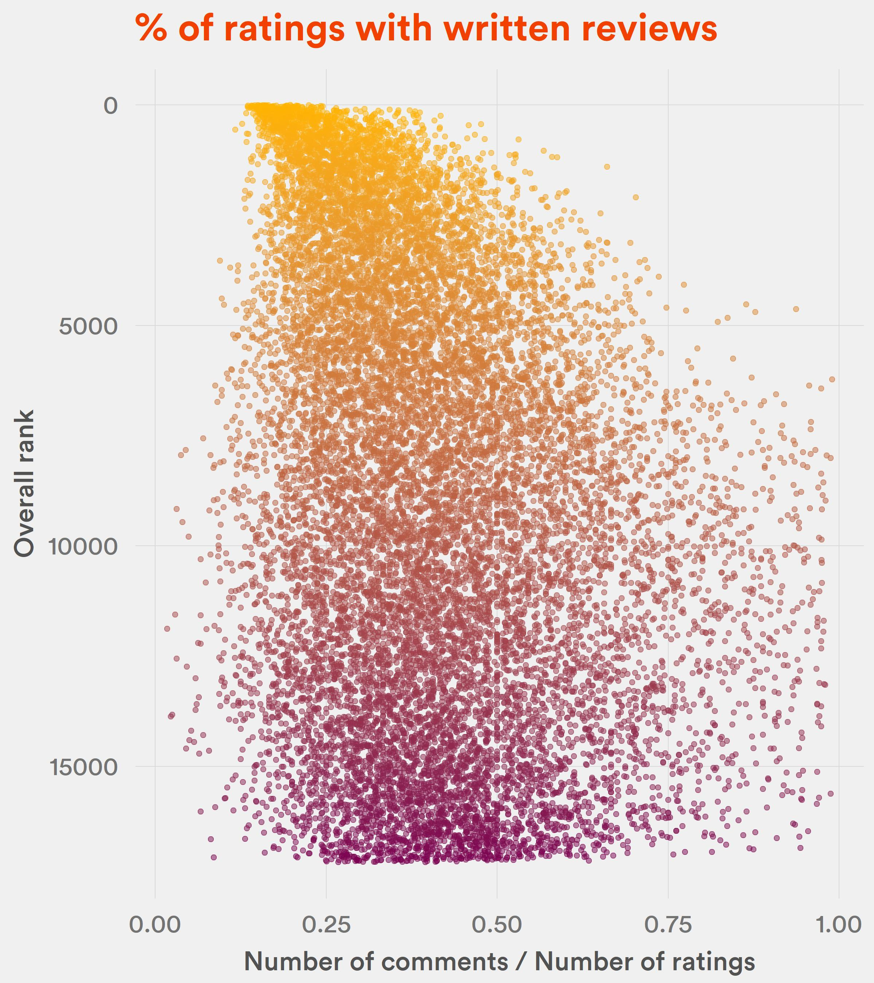
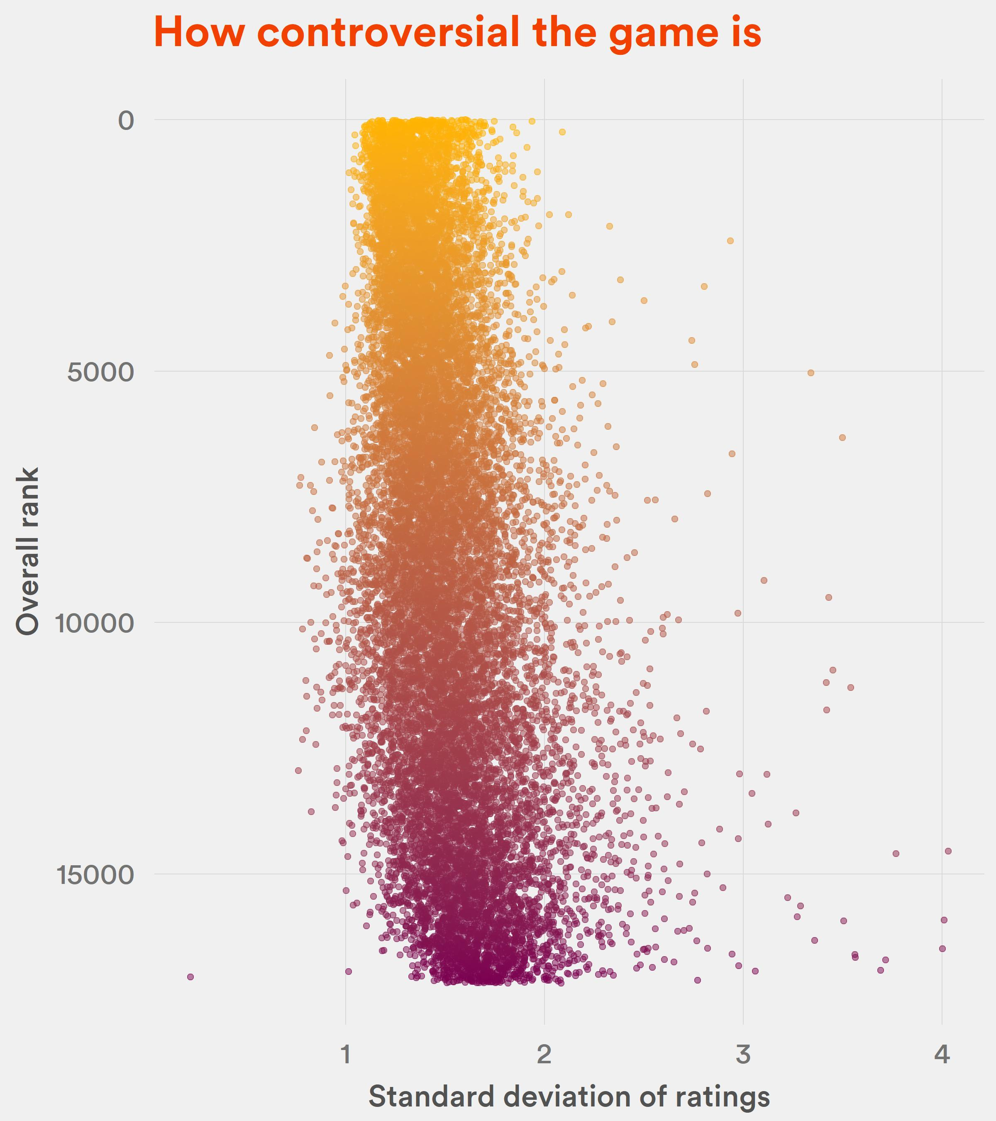

Slide 21
So, how to be in the top of BGG ranking?
Must be new, or even better – not yet published.
Must be super complex.
Must have a lot of reviews.
Must have quite good rating (but they don’t have to be the best!).
Or just release a strategy game.

Slide 22
Thank you!

